Slide 1
Advance Wordbook
By Prafull Varshney
2nd Year CSI branch
Roll No: 1802911032

Slide 2

Introduction
Spelling corrector
Search meaning of word
Search full form also
Play game
Online search is also possible

Slide 3

Tools and Technology used
C language
Code::blocks (IDE)
GNU GCC Compiler

Slide 4
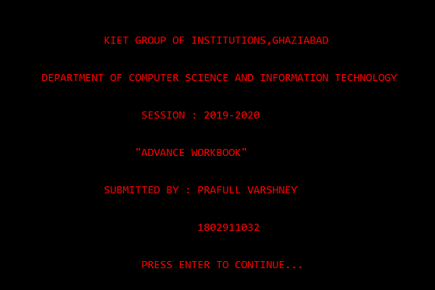
Features
Offline dictionary
Search by length of word
Search by starting letter of word
Search by ending letter of word
Search by occurrence of each letter
Online search possible
Full form search
Game

Slide 5
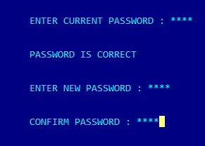
Security
Password
Hiding password
Maximum 3 times trial
Password change possible
Password change require current password
New Password confirmation

Slide 6
Glimpses…

Slide 7
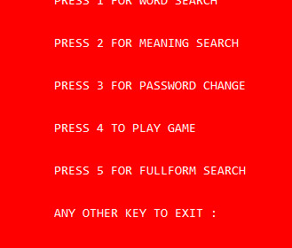
Main menu
All facilites with corresponding option.

Slide 8
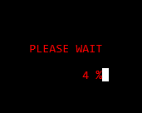
Loading…
Number appear to be changed with different speed.

Slide 9
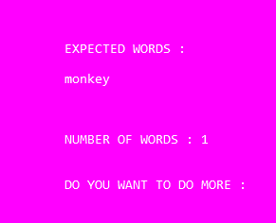
Word by length
Enter length, starting or ending letter of word.

Slide 10
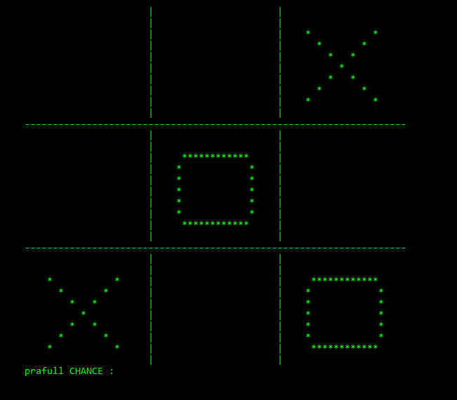
Game
Two member with two different color to represent them

Slide 11
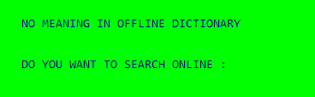
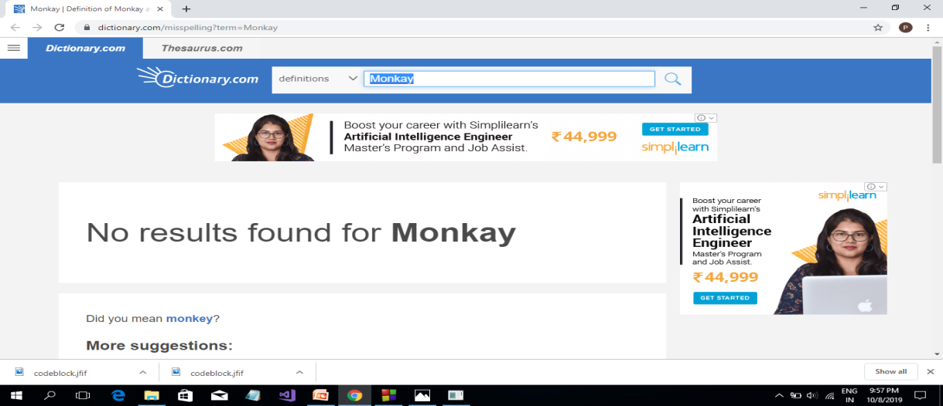
Online faclities for word,full form
Direct to the word’s meaning or full form

Slide 12

Future scope of improvement
Pronounciation of words
Limited words
Limited full form
Hindi to english conversion
Required space for file

Slide 13


